Slide 1


SNO Single Node OpenShift
Glenn West
gwest@redhat.com

Slide 2
Prereqs
DNS Entries
Bios
DHCP
Disk / ISO

Slide 3
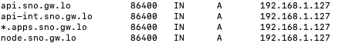
DNS Setup
4 entries
Api internal, api external
Node entry
App wildcard

Slide 4
DHCP Settings
add address=192.168.1.0/24 comment=defconf dns-server=8.8.8.8 domain=gw.lo \
gateway=192.168.1.1 netmask=24 ntp-server=192.168.1.1
add code=6 name=dns-dev value="'192.168.1.154'"
add code=12 name=hostname-node.sno.gw.lo value="s'node.sno.gw.lo'"
add address=192.168.1.127 dhcp-option=hostname-node.sno.gw.lo,dns-dev \
mac-address=02:D1:1E:FF:ED:15

Slide 5
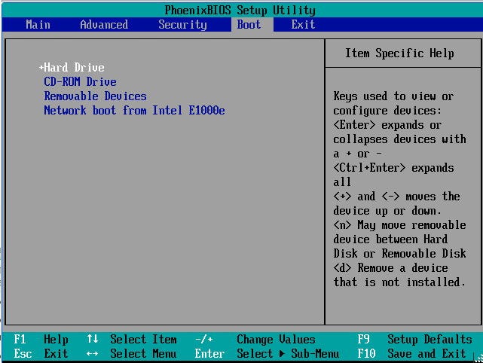
BIOS Settings

Slide 6
Disk and ISO
Drive should be erased
Use the online assisted installer to configure and create discovery iso
Download to where you can use the iso for ipmi or vm

Slide 7
Assisted Installer
Used Online at: https://cloud.redhat.com/openshift/assisted-installer/clusters/
Can also be used via api see: https://github.com/openshift/assisted-service/blob/master/docs/cloud.md
Can also be run locally
Current Version for ocp sno is 4.8.0.fc3

Slide 8
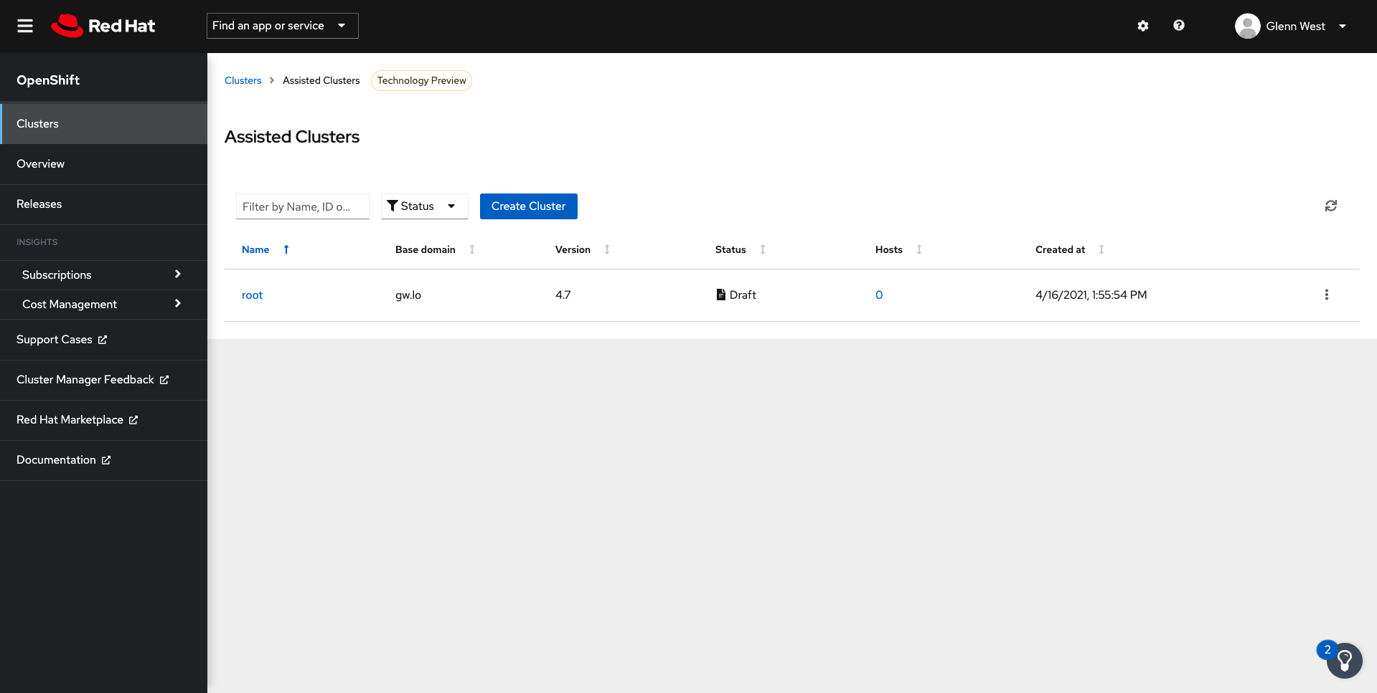
Assisted Installer

Slide 9
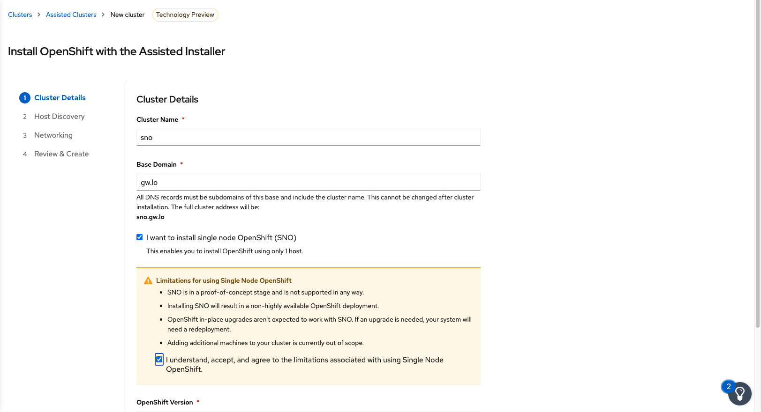
Create New Cluster

Slide 10
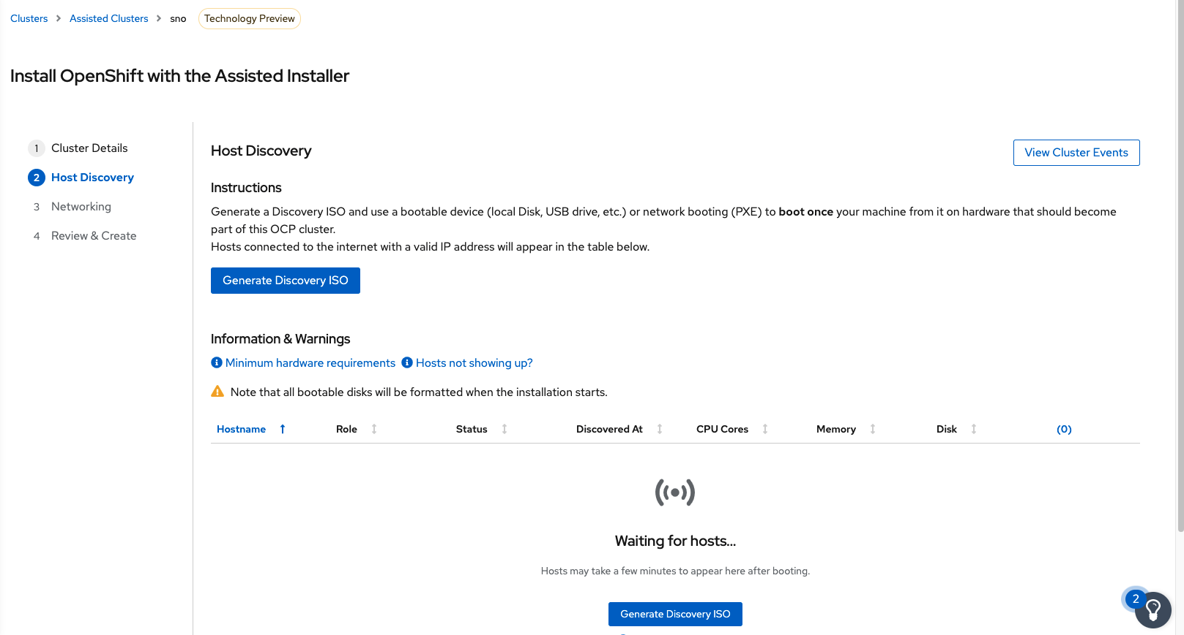
Create the Discovery ISO

Slide 11
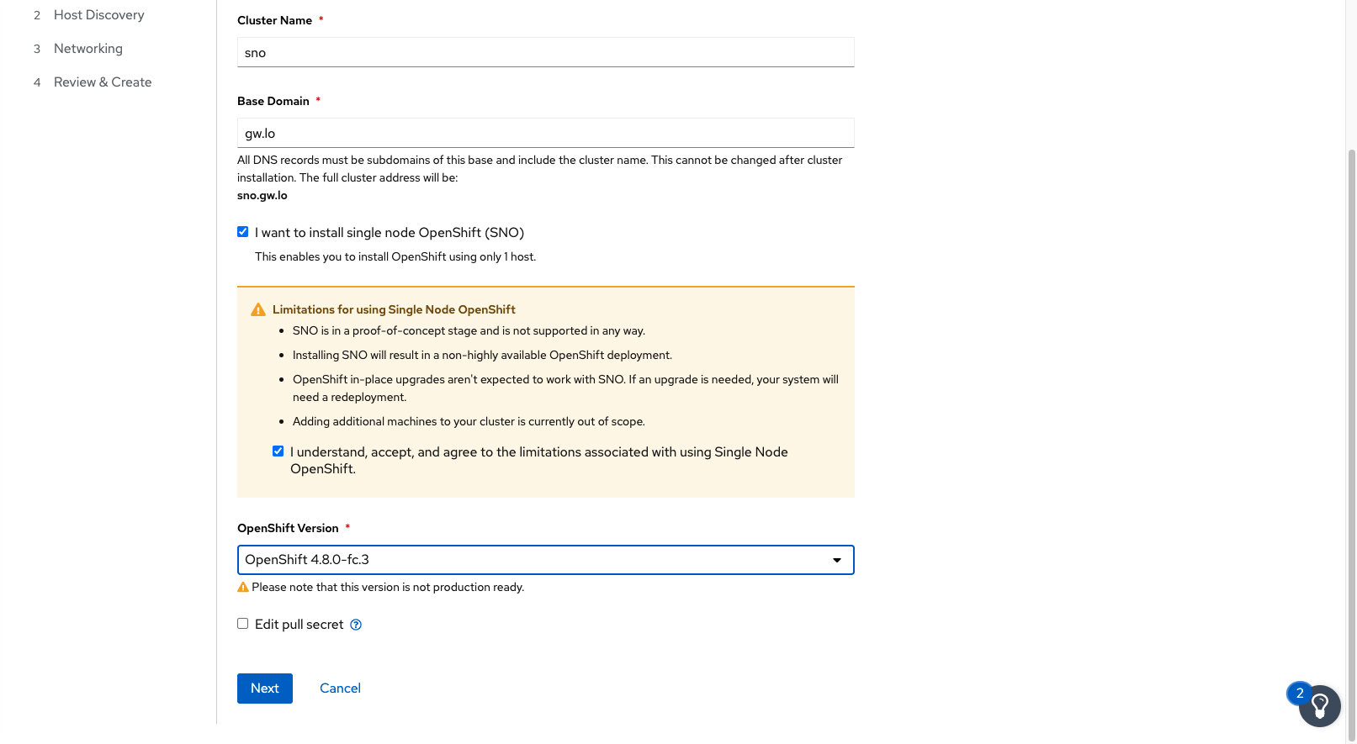
Select sno and version

Slide 12
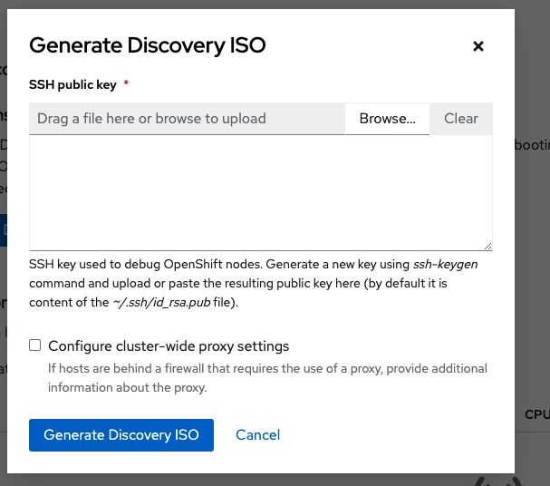
Start the iso generation

Slide 13
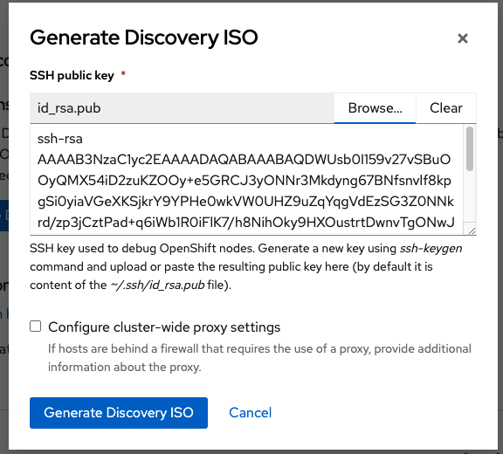
Add in your ssh key

Slide 14
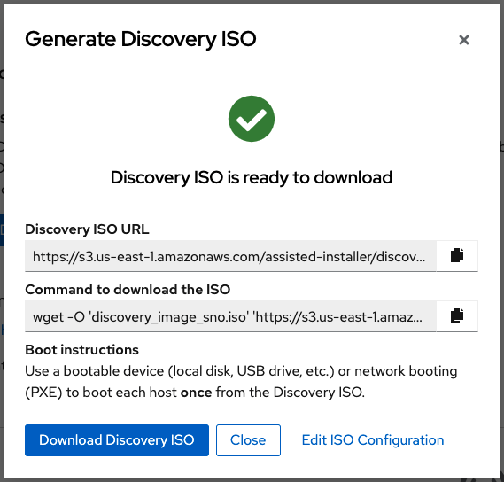
Download the iso to where you can use it

Slide 15
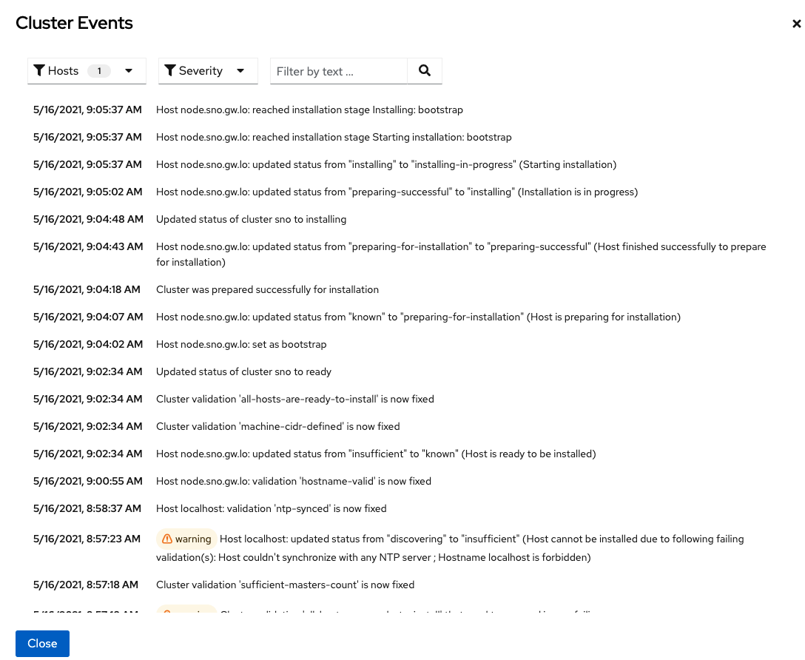

Slide 16
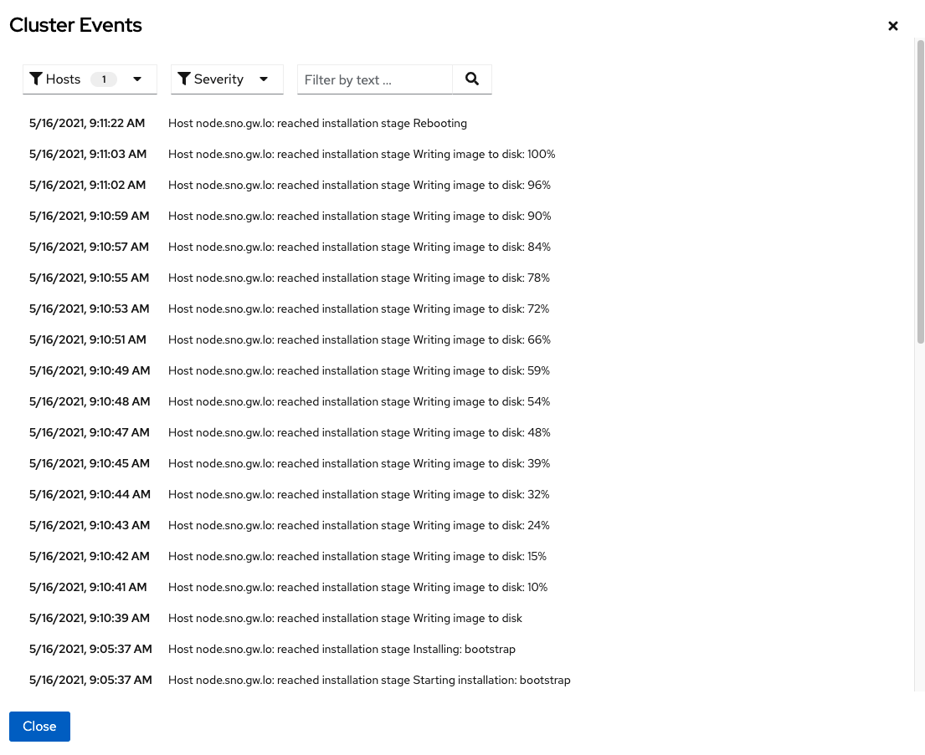

Slide 17
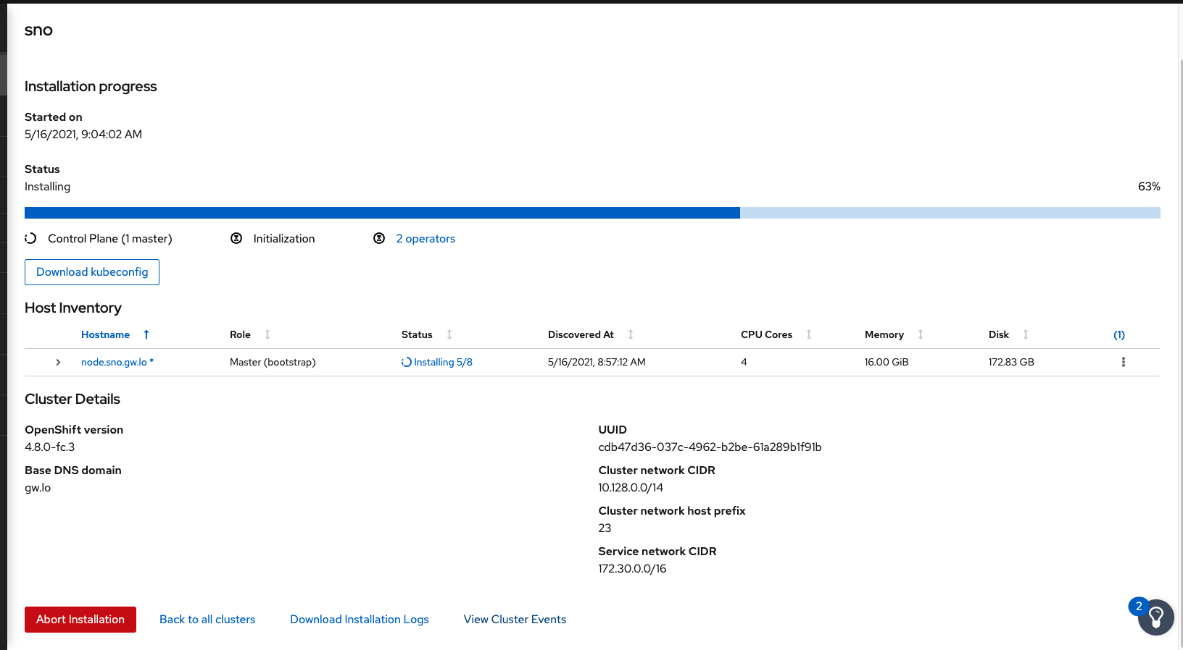

Slide 18
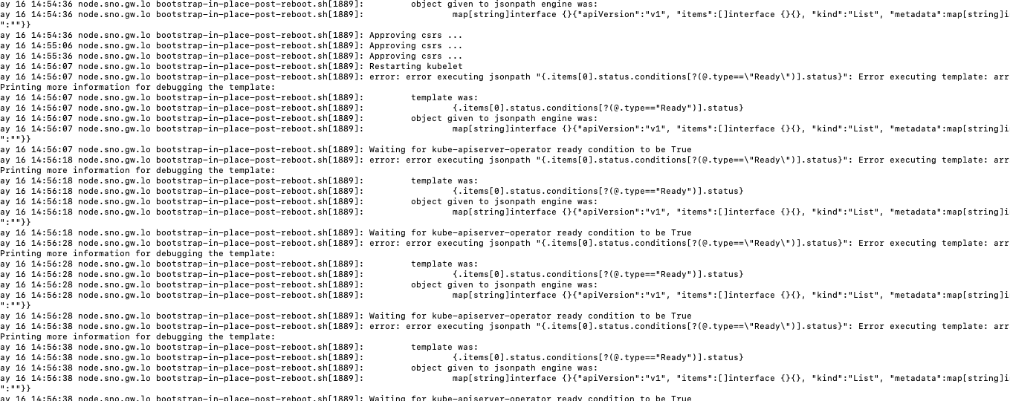

Slide 19
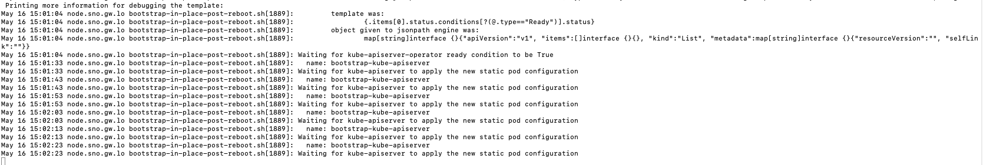

Slide 20
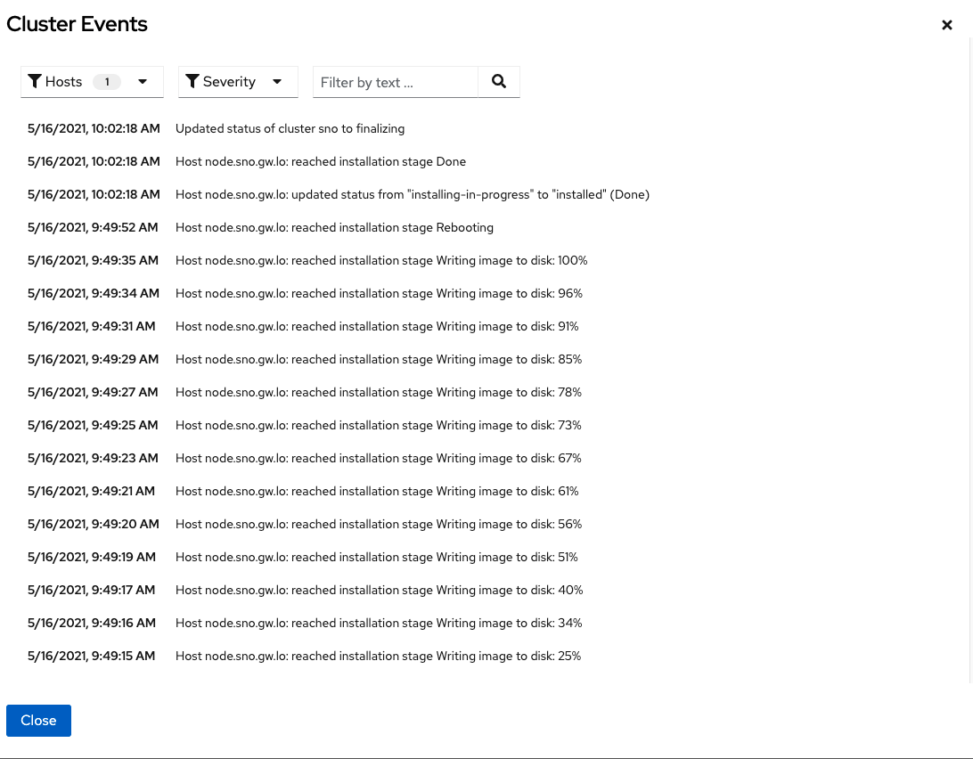

Slide 21
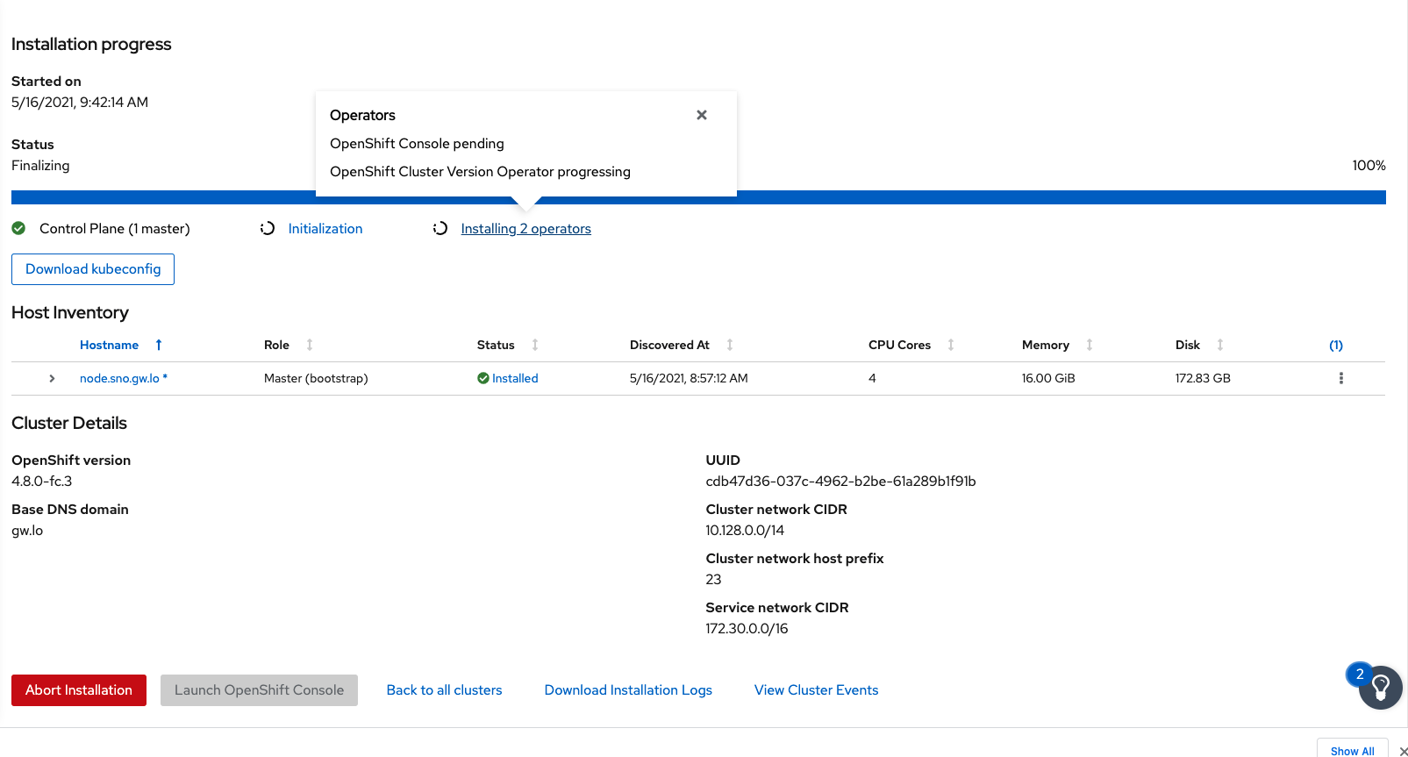

Slide 22
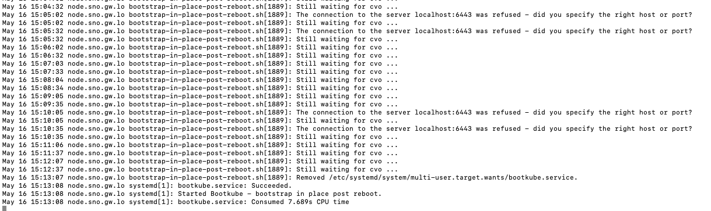

Slide 23
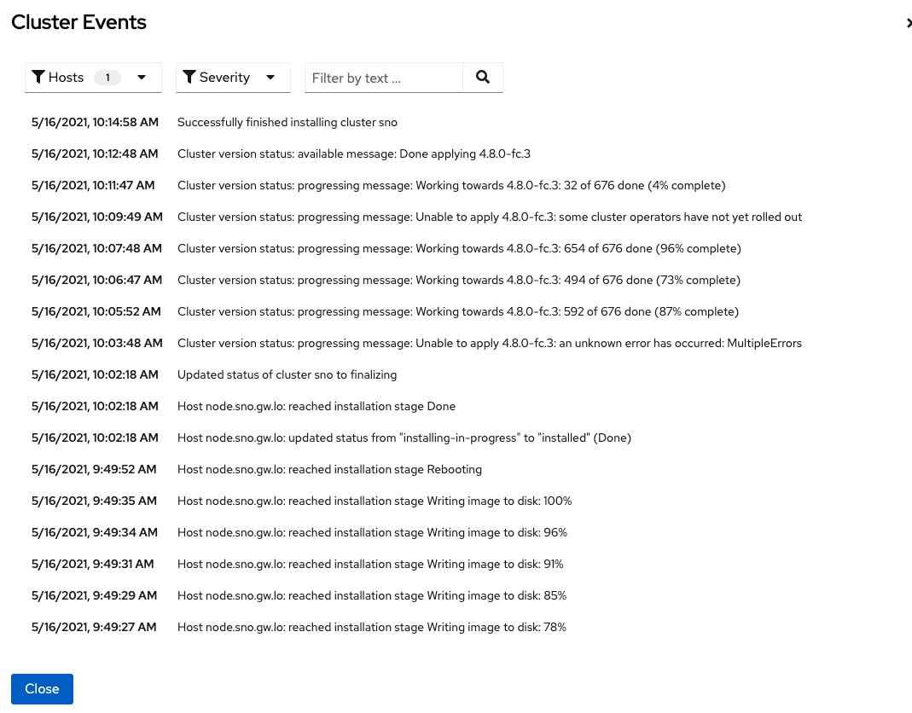

Slide 24
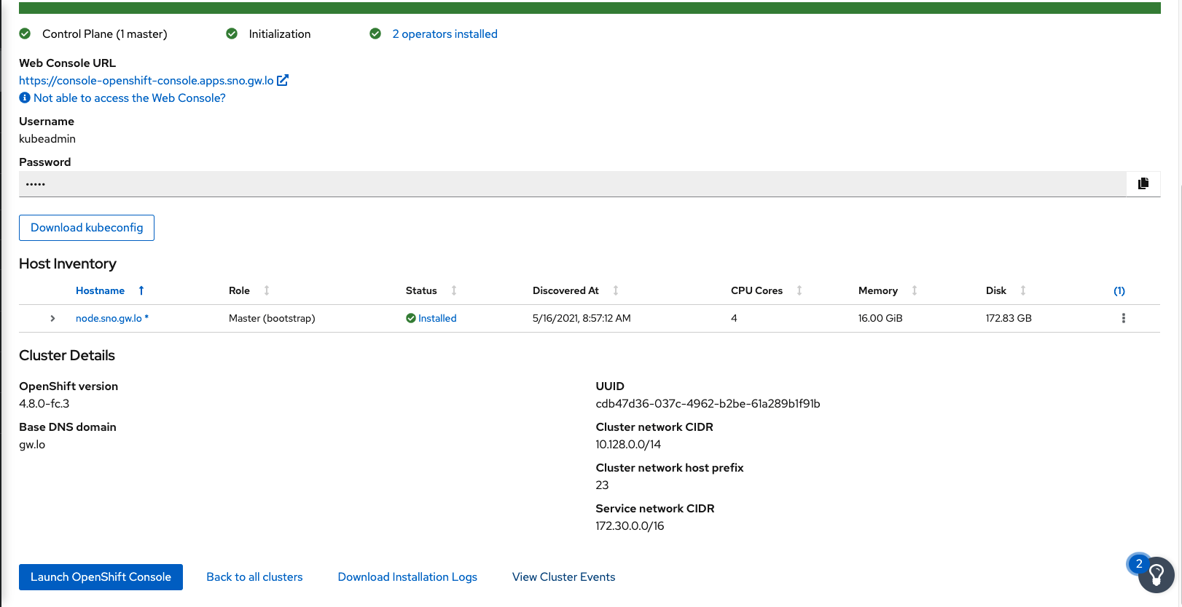

Slide 25
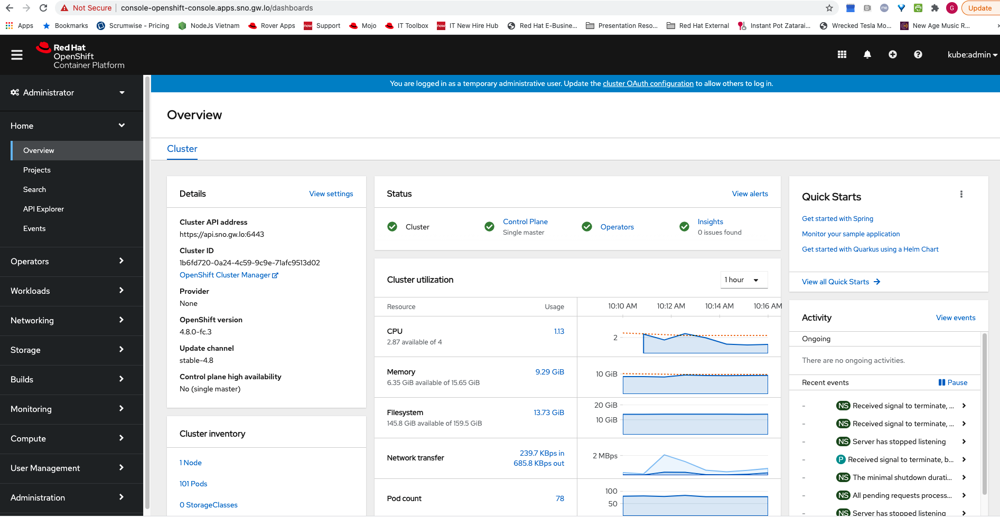

Slide 26
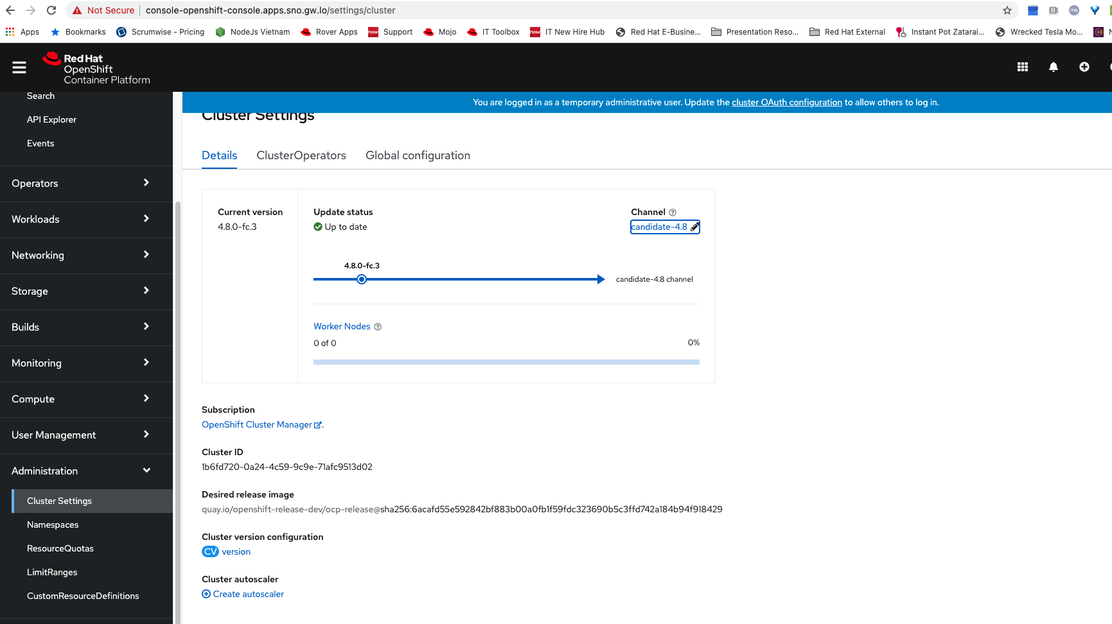

Slide 27
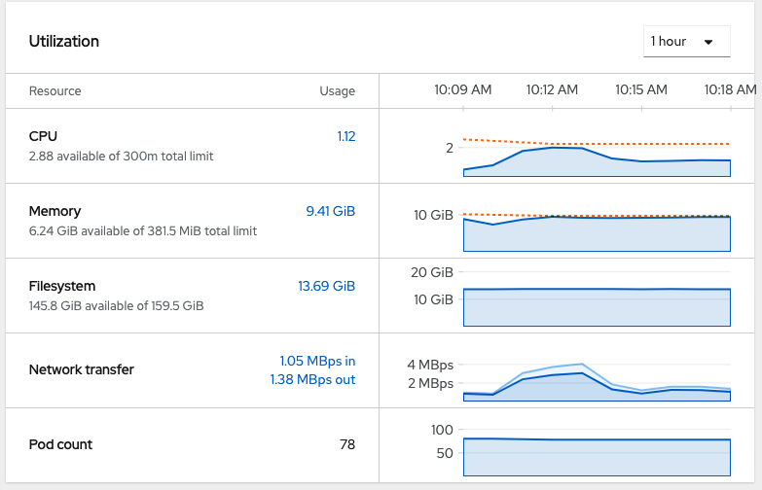

Slide 28
Timing
6 minutes for writing imaging to disk
12 minutes in rebooting phase
33 minutes total for install

Slide 29
Issues
Boot order is important, install will fail otherwise
DHCP may not set the host name, and install will fail. (Seen it once on creating slides)
Ssh will fail if hostname is not set

